Slide 1
Capstone Project - 4
Book Recommendation System
Team Members
Amir Khan Saurabh Daund Het Kothari Kamya Malhotra Mouleena Jaiswal

Slide 2

Table of contents:
Introduction
Defining Problem Statement
Data Overview
Exploratory Data Analysis
Model Creation
Model Evaluation

Slide 3
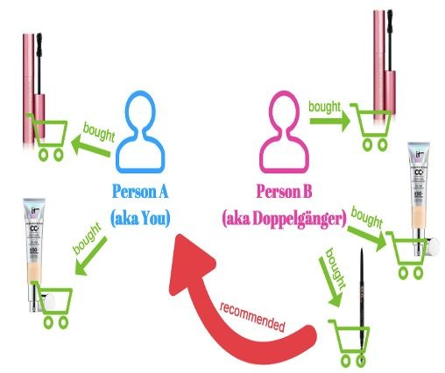
Introduction
Recommender systems are machine learning systems that help users discover new product and services.
A recommendation system helps an organization to create loyal customers and build trust by them desired products and services for which they came on your site.
A book recommendation system is a type of recommendation system where we have to recommend similar books to the reader based on his/her interest. The books recommendation system is used by online websites which provide ebooks like google play books, open library, goodReads, etc.

Slide 4
Problem Statement
During the last few decades, with the rise of Youtube, Amazon, Netflix, and many other such web services, recommender systems have taken more and more place in our lives. From e-commerce (suggest to buyers articles that could interest them) to online advertisement (suggest to users the right contents, matching their preferences), recommender systems are today unavoidable in our daily online journeys.
In a very general way, recommender systems are algorithms aimed at suggesting relevant items to users (items being movies to watch, text to read, products to buy, or anything else depending on industries).
Recommender systems are really critical in some industries as they can generate a huge amount of income when they are efficient or also be a way to stand out significantly from competitors. The main objective is to create a book recommendation system for users.

Slide 5

Data Overview
Understanding datasets better:
The Book-Crossing dataset comprises 3 files.
Users
Contains the users. Note that user IDs (User-ID) have been anonymized and map to integers. Demographic data is provided (Location, Age) if available. Otherwise, these fields contain NULL values.
Books
Books are identified by their respective ISBN. Invalid ISBNs have already been removed from the dataset. Moreover, some content-based information is given (Book-Title,Book-Author, Year-Of-Publication, Publisher), obtained from Amazon Web Services. Note that in the case of several authors, only the first is provided. URLs linking to cover images are also given, appearing in three different flavors (Image-URL-S, Image-URL-M, Image-URL-L), i.e., small, medium, large. These URLs point to the Amazon website.
Ratings
Contains the book rating information. Ratings (Book-Rating) are either explicit, expressed on a scale from 1-10 (higher values denoting higher appreciation), or implicit, expressed by 0.

Slide 6
Continued...
Understanding attributes of data set better:
Books:'ISBN', 'Book-Title', 'Book-Author', 'Year-Of-Publication', ‘Image-URL-M', 'Image-URL-L'
Users:’User-ID’,’Location’,’Age’
Ratings:’User-ID’,’ISBN’,’Book Rating’
'Publisher', 'Image-URL-S',
Summarize the data by identifying key characteristics, such as data volume and total number of variables in the data.
Book :Number of rows in our dataset are 271360 Number of columns in our dataset are 8
Users:Number of rows in our dataset are 278858 Number of columns in our dataset are 3
Ratings:Number of rows in our dataset are 1149780
Number of columns in our dataset are 3

Slide 7
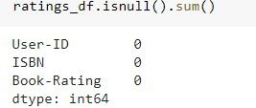
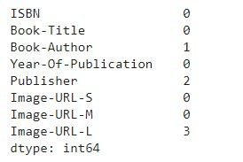
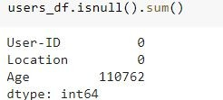
Continued...
Understand the problems with the data, such as missing values, inaccuracies, and outliers.
Book Users Ratings
There are NAN/NULL values in our book dataset and we have dropped these values.

Slide 8

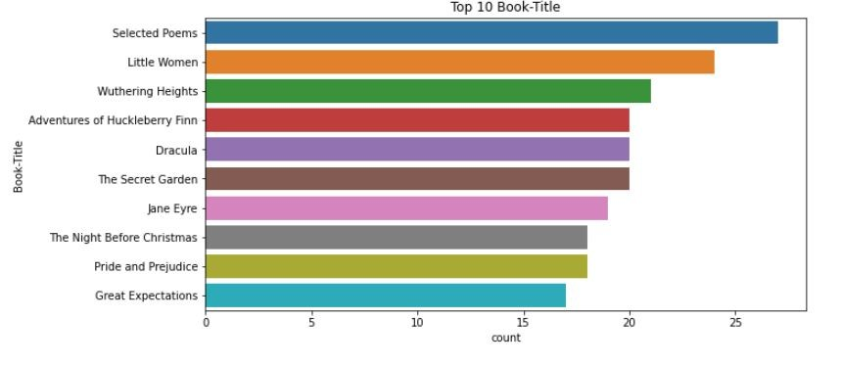
EDA
1. Book Title
We have 2,42,130 unique Book Title.
The top most book title found is Selected Poems.
Selected Poems is present in 27 rows in books data.
jjjj

Slide 9
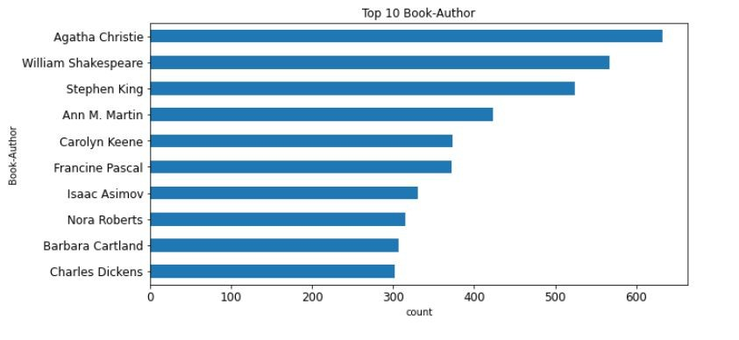
2. Book Author
We have 1,02,020 unique Author.
The top most author found is Agatha Christie.
We have 632 Agatha Christie in books data.

Slide 10
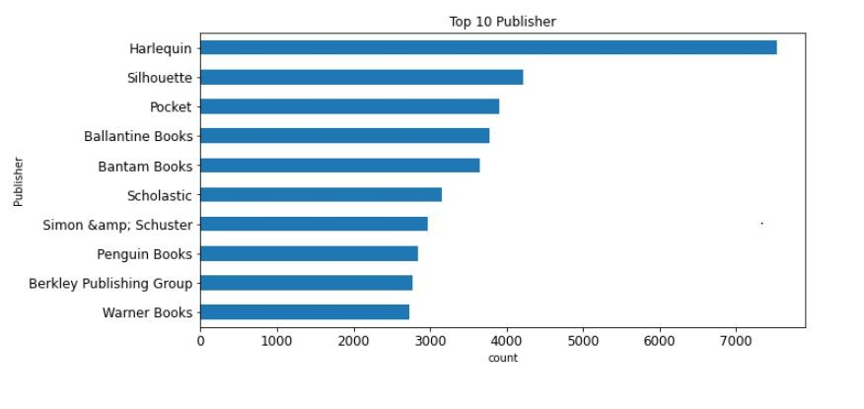
3. Publisher
We have 16,803 unique Publishers.
The top most publisher found is Harlequin.
We have 7,535 Harlequin in books data.

Slide 11
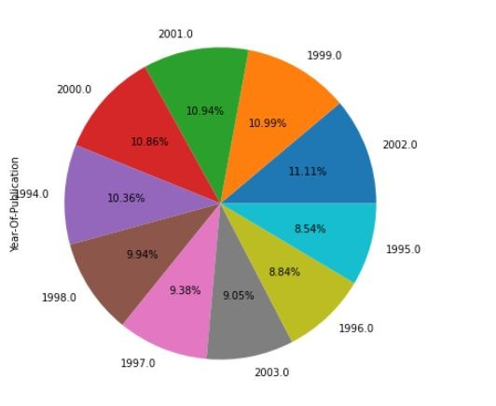
4. Year of
Publication
Most books were published in the year of 2002.

Slide 12
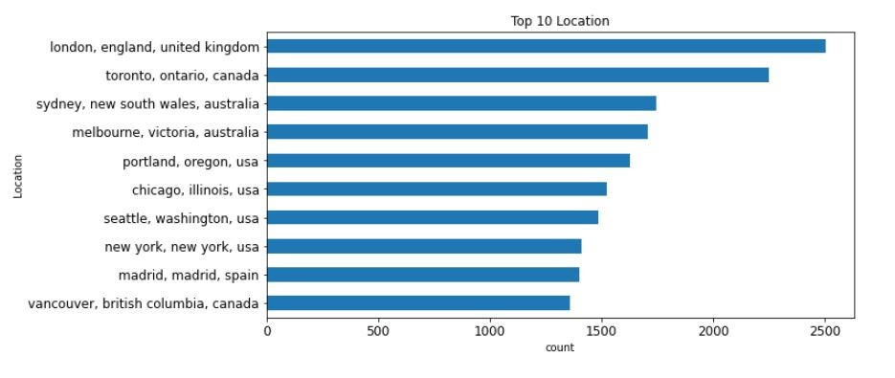
EDA
5. Location
In these plot , we can see top 10 users location.
The top most location is London, England, United Kingdom
We have around 2500 users from London.

Slide 13
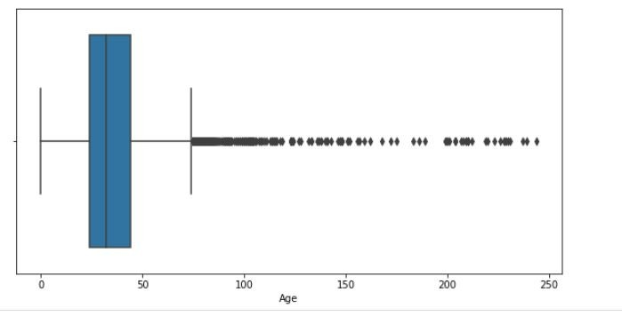
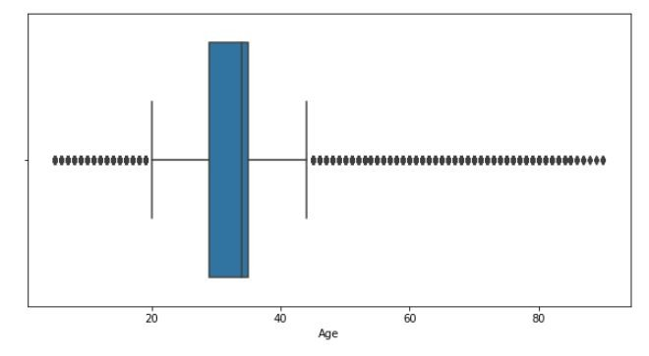
EDA
6. Age
Before Age Outlier Removal
After Age Outlier Removal
Remove the Age greater than 90 and less than 5
Remove the Age greater than 90 and less than 5.

Slide 14
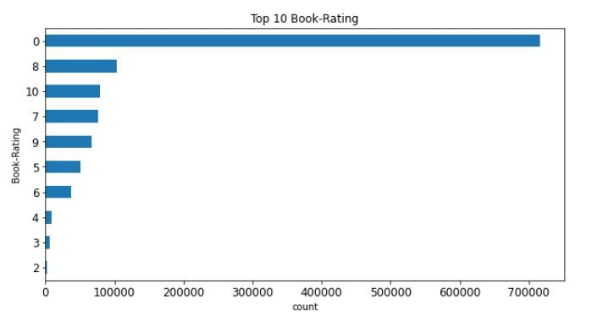
EDA
Location
Highest rating is 8 out of 10.
Lowest rating is 2 out of 10.
Most of the people haven't given the ratings.
.

Slide 15
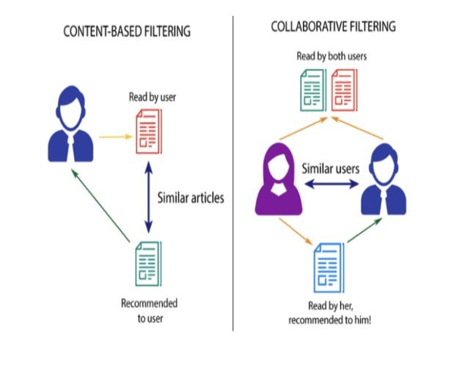
Model Creation
Recommendation system is usually classiﬁed on rating estimation:
Collaborative Filtering system
Content based system
Hybrid based system

Slide 16
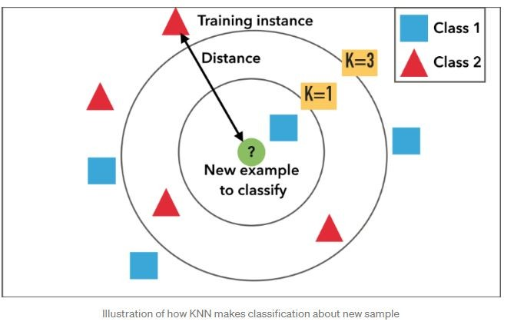
Collaborative Filtering Using k-Nearest Neighbors (kNN)
kNN is a machine learning algorithm to find clusters of similar users based on common book ratings, and make predictions using the average rating of top-k nearest neighbors.

Slide 17
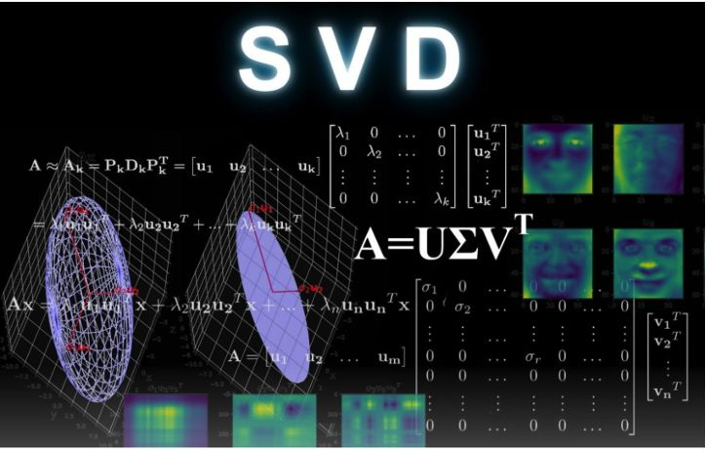
Collaborative Filtering Using Singular Value Decomposition (SVD)
The Singular-Value Decomposition, is a matrix decomposition method for reducing a matrix to its constituent parts in order to make certain subsequent matrix calculations simpler. It provides another way to factorize a matrix, into singular vectors and singular values.

Slide 18
Evaluation
In Recommender Systems, there are a set metrics commonly used for evaluation. We choose to work with Top-N accuracy metrics, which evaluates the accuracy of the top recommendations provided to a user, comparing to the items the user has actually interacted in test set.
This evaluation method works as follows:
For each user
For each item the user has interacted in test set
Sample 100 other items the user has never interacted.
Ask the recommender model to produce a ranked list of recommended items, from a set composed of one interacted item and the 100 non-interacted items
Compute the Top-N accuracy metrics for this user and interacted item from the recommendations ranked list
Aggregate the global Top-N accuracy metrics

Slide 19
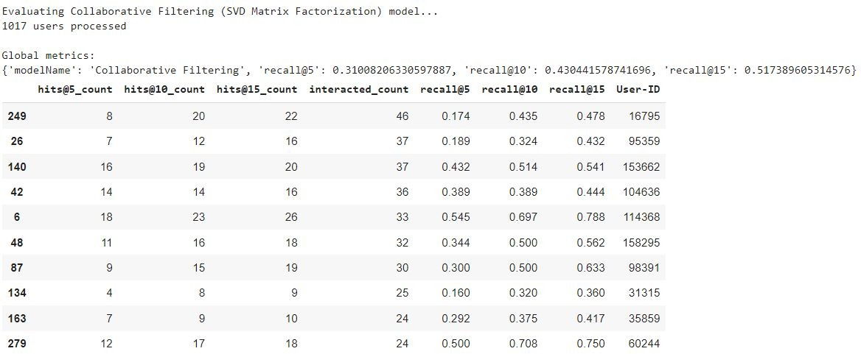
Evaluation Contd.

Slide 20

Conclusion
As we can see, after implementing Collaborative Filtering and evaluating it using SVD matrix we are
satisﬁed with the results. A recall rate of around 50 for hit@15 is fair enough for such a large dataset. Also since it is an unsupervised learning algorithm trying to ﬁnd good books that users will like which in itself is a very vast and complicated study.

Slide 21
Challenges
High Volume of Data.
Elevating evaluation score for the models.
Crashing of session due to large pivot matrix.
Choosing optimal number of Factors in SVD.

Slide 22


THANK YOU!!

